Slide 1


An extensible double pendulum and multiple parametric resonances
Shihabul Haque¹ (speaker), Nilanjan Sasmal¹ and Jayanta K. Bhattacharjee²
¹Indian Association for the Cultivation of Science, Kolkata, India
²Indian Institute of Technology, Kanpur, India
NODYCON 2023, Rome, June 18-22, 2023

Slide 2
Motivation & Introduction
Olsson (1976) showed that the elastic pendulum displays parametric resonance when the frequency ratio of the two modes are double of each other (ꞷ_{spring} = 2ꞷ_{pendulum}). Further work was done by Lai (1984), who came up with a description of the amplitudes at around the resonant condition, and it was established later that the system shows strongly chaotic dynamics (Van der Weele et. al. (1996), Anurag et. al. (2020)).
Building on the extensive literature on the elastic pendulum, we take a look at the elastic double pendulum, the lower pendulum being the elastic one and investigate the possibilities for parametric resonance in the same.
We find four different conditions that give rise to resonance, two of which have been observed in other systems (frequency ratio 2) and two which are unique to ours.
We consider the numerical solutions to the system at these four resonant conditions and look at the time evolution of the modes as well as the time series of the same in the phase space.
We also show that the system has a positive (and large) Lyapunov exponent affirming our claim that the dynamics is strongly chaotic.

Slide 3
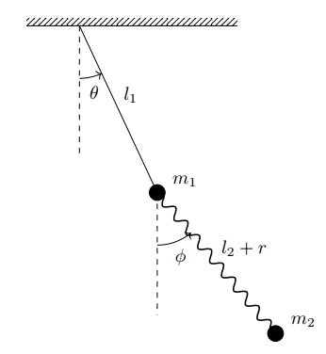
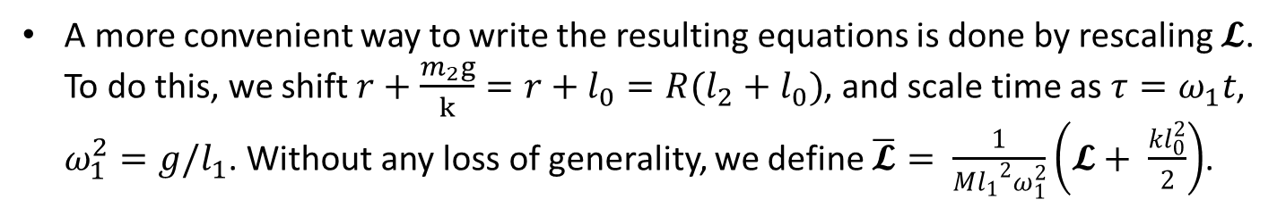
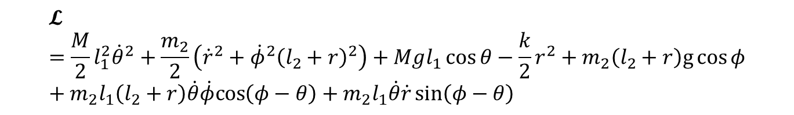
The system
NODYCON 2023
The system we consider is displayed on the left:
We have a double pendulum with 2 masses, m₁ and m₂. The string connecting m₁ to the pivot point is inextensible but the masses are connected together by a spring with a spring constant, k.
The Lagrangian of our system is then given by,
$$𝓛=\frac{M}{2}l_{1}^{2}{\dot{θ}}^{2}+\frac{m_{2}}{2}\left({\dot{r}}^{2}+{\dot{φ}}^{2}{\left(l_{2}+r\right)}^{2}\right)+Mgl_{1}\cos{θ}−\frac{k}{2}r^{2}+m_{2}\left(l_{2}+r\right)g\cos{φ}+m_{2}l_{1}\left(l_{2}+r\right)\dot{θ}\dot{φ}cos\left(φ−θ\right)+m_{2}l_{1}\dot{θ}\dot{r}\sin\left(φ−θ\right)$$
Third International Nonlinear Dynamics Conference
A more convenient way to write the resulting equations is done by rescaling $𝓛$. To do this, we shift $r+\frac{m_{2}g}{k}=r+l_{0}=R(l_{2}+l_{0})$, and scale time as $τ=ω_{1}t$, $ω_{1}^{2}=g/l_{1}$. Without any loss of generality, we define $\overline{𝓛}= \frac{1}{M{{l_{1}}^{2}ω}_{1}^{2}}\left(𝓛+ \frac{kl_{0}^{2}}{2}\right)$.
Fig 1: The system

Slide 4
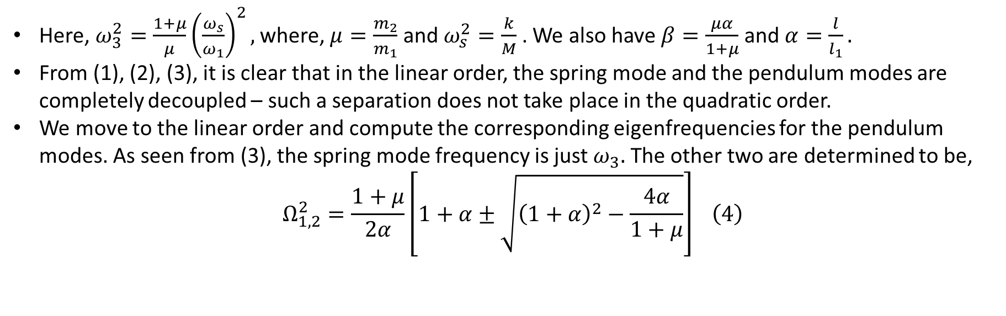
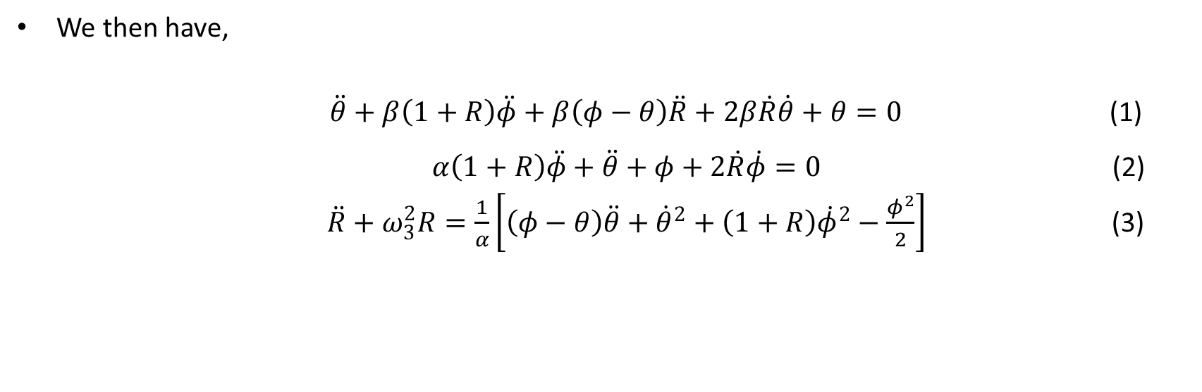
The system (continued)
We then have,
$\ddot{θ}+β\left(1+R\right)\ddot{φ}+β\left(φ−θ\right)\ddot{R}+2β\dot{R}\dot{θ}+θ=0$ (1)
$α\left(1+R\right)\ddot{φ}+\ddot{θ}+φ+2\dot{R}\dot{φ}=0$ (2)
$\ddot{R}+ω_{3}^{2}R=\frac{1}{α}\left[\left(φ−θ\right)\ddot{θ}+{\dot{θ}}^{2}+\left(1+R\right){\dot{φ}}^{2}−\frac{φ^{2}}{2}\right]$ (3)
Here, $ω_{3}^{2}=\frac{1+μ}{μ}{\left(\frac{ω_{s}}{ω_{1}}\right)}^{2},$ where, $μ=\frac{m_{2}}{m_{1}}$ and $ω_{s}^{2}=\frac{k}{M}$. We also have $β=\frac{μα}{1+μ}$ and $α=\frac{l}{l_{1}}.$
From (1), (2), (3), it is clear that in the linear order, the spring mode and the pendulum modes are completely decoupled – such a separation does not take place in the quadratic order.
We move to the linear order and compute the corresponding eigenfrequencies for the pendulum modes. As seen from (3), the spring mode frequency is just $ω_{3}.$ The other two are determined to be,
$$\begin{aligned} Ω_{1,2}^{2}=\frac{1+μ}{2α}\left[1+α±\sqrt{{\left(1+α\right)}^{2}−\frac{4α}{1+μ}}\right] \#\left(4\right)\end{aligned}$$

Slide 5
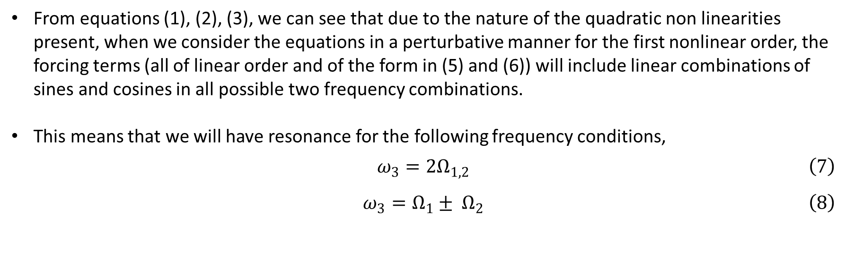
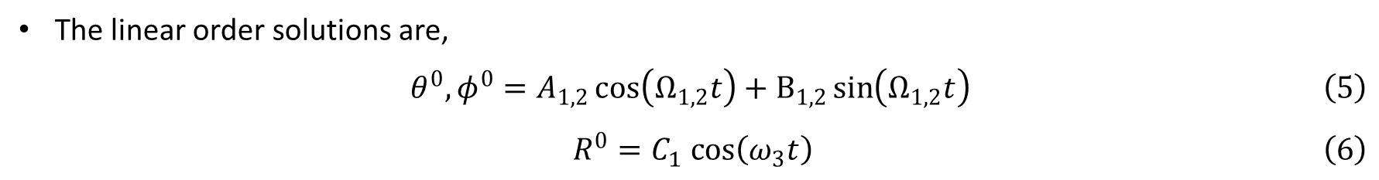
Resonance
The linear order solutions are,
$$\begin{aligned} θ^{0}, φ^{0}=A_{1,2}\cos\left(Ω_{1,2}t\right)+B_{1,2}\sin\left(Ω_{1,2}t\right) \#\left(5\right)\end{aligned}$$
$$\begin{aligned} R^{0}=C_{1} cos\left(ω_{3}t\right) \#\left(6\right)\end{aligned}$$
From equations (1), (2), (3), we can see that due to the nature of the quadratic non linearities present, when we consider the equations in a perturbative manner for the first nonlinear order, the forcing terms (all of linear order and of the form in (5) and (6)) will include linear combinations of sines and cosines in all possible two frequency combinations.
This means that we will have resonance for the following frequency conditions,
$$\begin{aligned} ω_{3}=2Ω_{1,2} \#\left(7\right)\end{aligned}$$
$$\begin{aligned} ω_{3}=Ω_{1}± Ω_{2} \#\left(8\right)\end{aligned}$$
The condition in eqn. (7) is quite well known and has been extensively studied in the references mentioned at the beginning and more. Eqn. (8) however presents a newer condition which, to the best of our knowledge, has not yet been found in any other system.

Slide 6
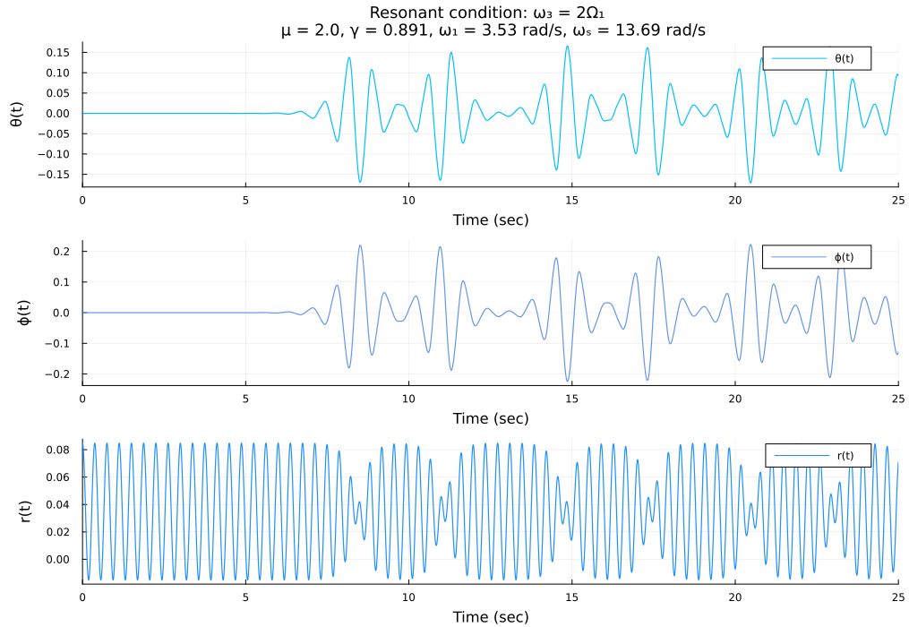
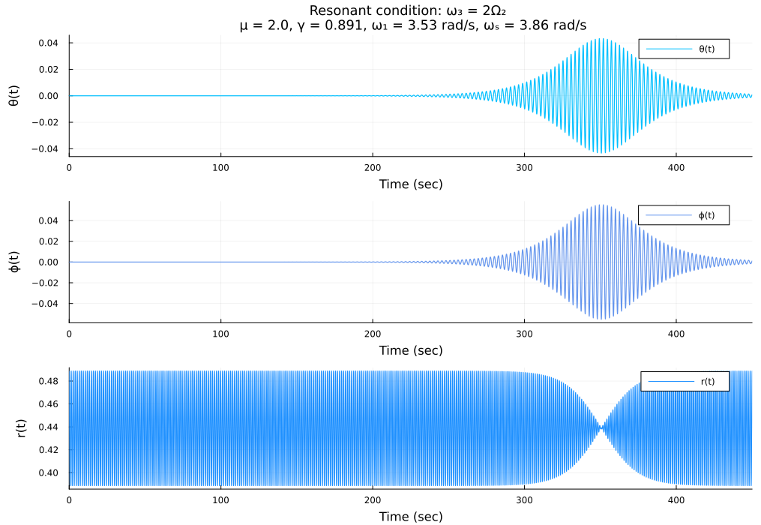
Numerical investigation
Knowing the resonance conditions (7) and (8) leads us to numerically solving the system for these fours different conditions. The results are summarised below.
Fig. 1: For $ω_{3}=2 Ω_{1,2}$

Slide 7
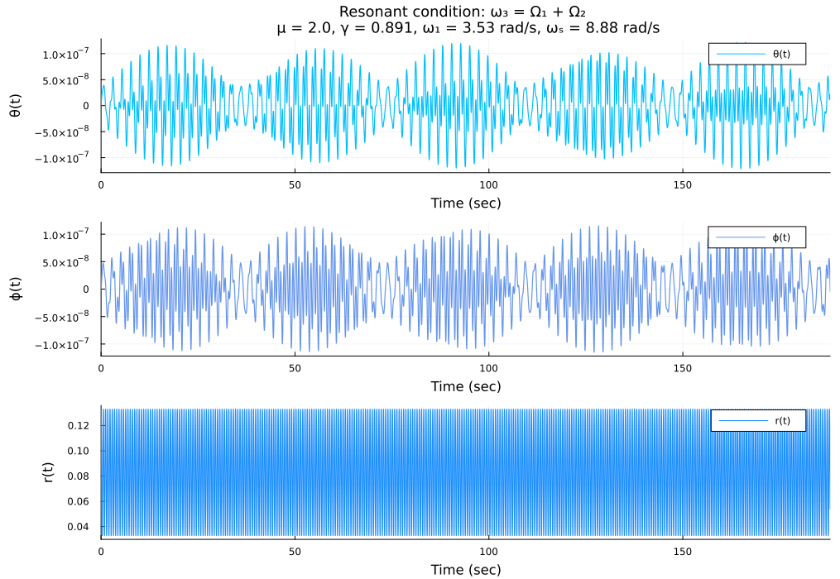
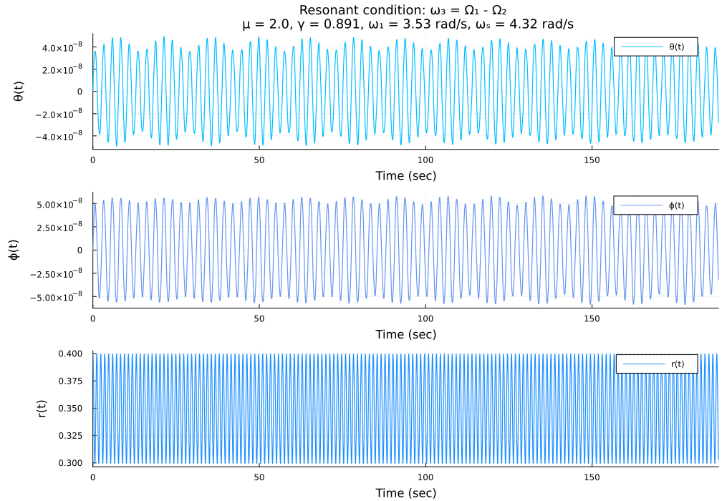
Numerical investigation (continued)
Fig. 2: For $ω_{3}= Ω_{1}±Ω_{2}$

Slide 8
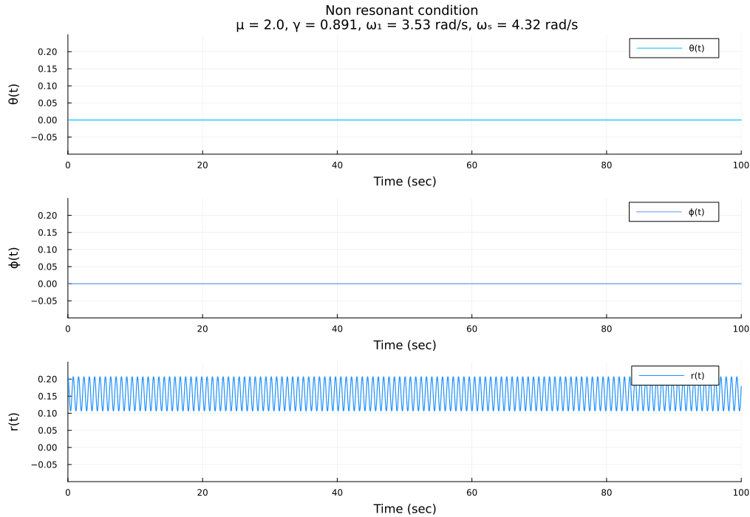
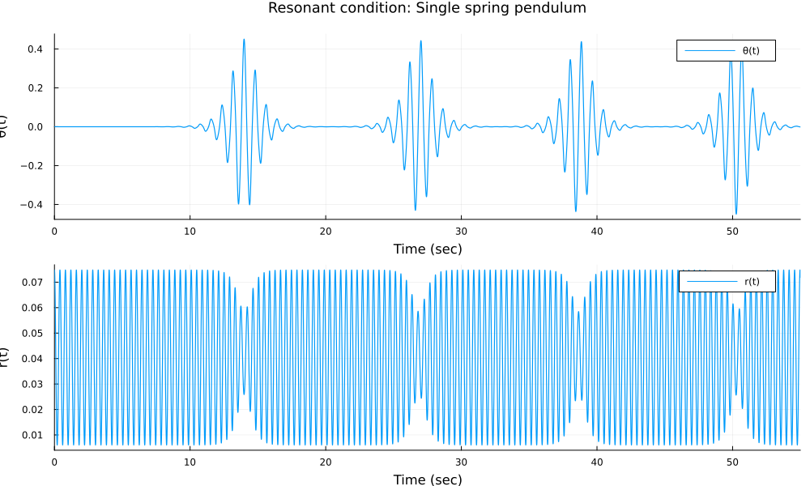
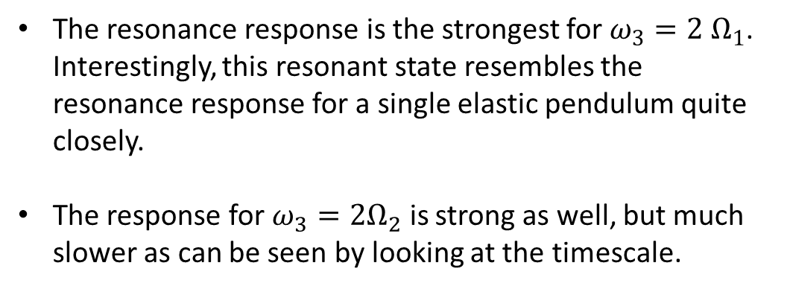
Numerical investigation (continued)
Figs. (1) and (2) depict the resonance responses. Fig. (3) depicts an arbitrary non-resonant case with the same initial conditions. The difference is quite clear.
The response is the weakest for the last two resonance conditions – however, the amplitude variation is periodic and regular.
Fig. 3: No resonance
The resonance response is the strongest for $ω_{3}=2 Ω_{1}$. Interestingly, this resonant state resembles the resonance response for a single elastic pendulum quite closely.
The response for $ω_{3}=2Ω_{2}$ is strong as well, but much slower as can be seen by looking at the timescale.
Fig. 4: Resonance in a single elastic pendulum

Slide 9
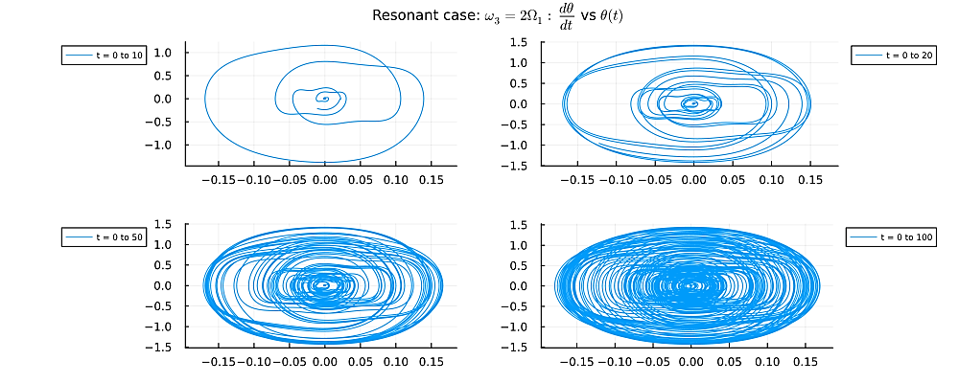
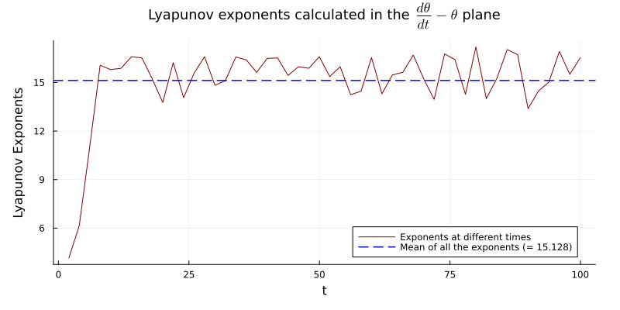
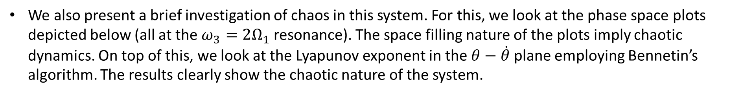
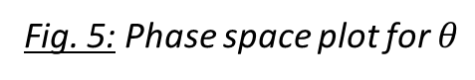
Chaos
We also present a brief investigation of chaos in this system. For this, we look at the phase space plots depicted below (all at the $ω_{3}=2Ω_{1}$ resonance). The space filling nature of the plots imply chaotic dynamics. On top of this, we look at the Lyapunov exponent in the $θ−\dot{θ}$ plane employing Bennetin’s algorithm. The results clearly show the chaotic nature of the system.
Fig. 5: Phase space plot for $θ$
Fig. 6: Evolution of the exponents

Slide 10
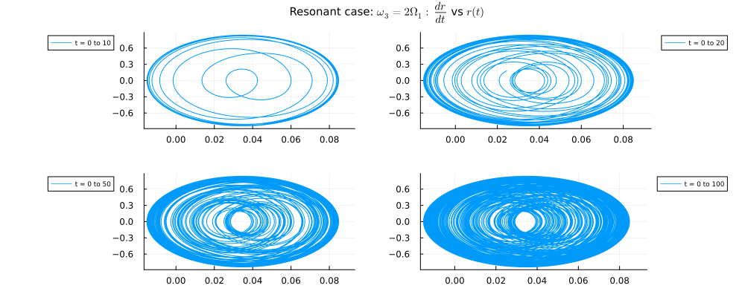
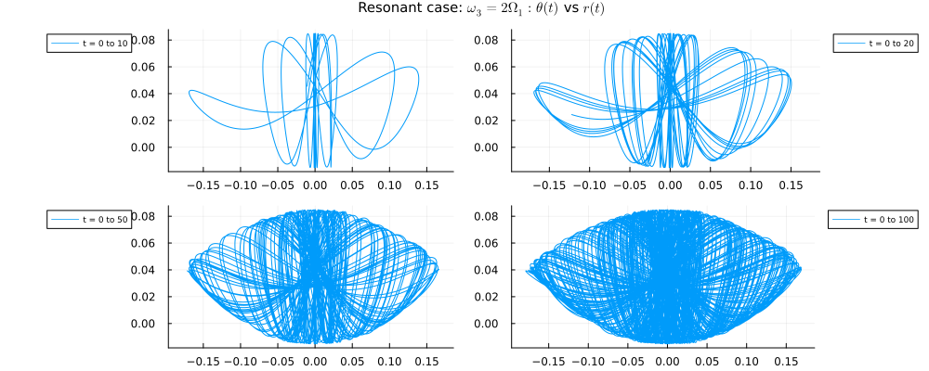
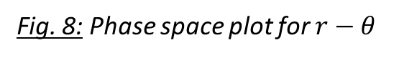
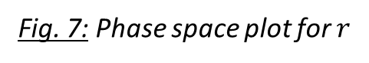
Chaos (continued)
Fig. 7: Phase space plot for $r$
Fig. 8: Phase space plot for $r−θ$

Slide 11
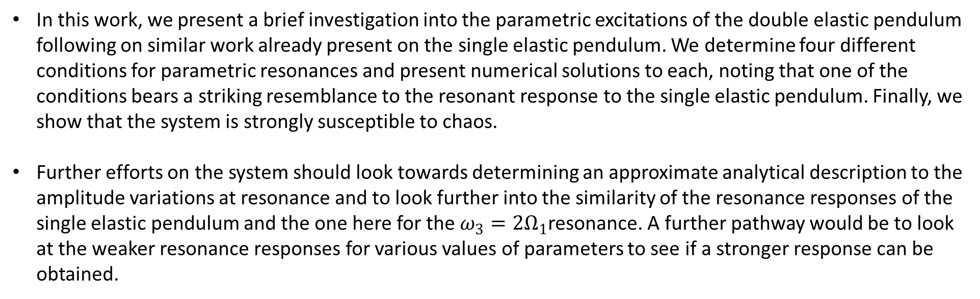
Discussions
In this work, we present a brief investigation into the parametric excitations of the double elastic pendulum following on similar work already present on the single elastic pendulum. We determine four different conditions for parametric resonances and present numerical solutions to each, noting that one of the conditions bears a striking resemblance to the resonant response to the single elastic pendulum. Finally, we show that the system is strongly susceptible to chaos.
Further efforts on the system should look towards determining an approximate analytical description to the amplitude variations at resonance and to look further into the similarity of the resonance responses of the single elastic pendulum and the one here for the $ω_{3}=2Ω_{1}$resonance. A further pathway would be to look at the weaker resonance responses for various values of parameters to see if a stronger response can be obtained.
References:
Olsson M. G. (1976) Why does a mass on a spring sometimes misbehave? Am. J. Phys. 44:1211-1212
Lai H. M. (1984) On the recurrence phenomenon of a resonant spring pendulum. Am. J. Phys. 52:219-223
Van der Weele J.P., & de Kleine E. (1996) The order-chaos-order sequence in the spring pendulum. Physica A 228:245-272
Anurag, Mondal B., Bhattacharjee J. K. & Chakraborty S. (2020) Understanding the order-chaos-order transition in the planar elastic pendulum. Physica D 402 132256
Balcerzak M., Pikunov D. & Dabrowski A. (2018) The fastest, simplified method of Lyapunov exponents spectrum estimation for continuous-time dynamical systems. Nonlinear Dyn 94:3053–3065

